Slide 1
DotaMatCh
Team A11
Corey chong
Albert SU
Evans Yeung

Slide 2
Overview
Background
Issues
Observations
Insight
Analysis
Analogy
Technical Diagrams
Motivation
Overall Goal
Post Implementation Review
Q/A

Slide 3
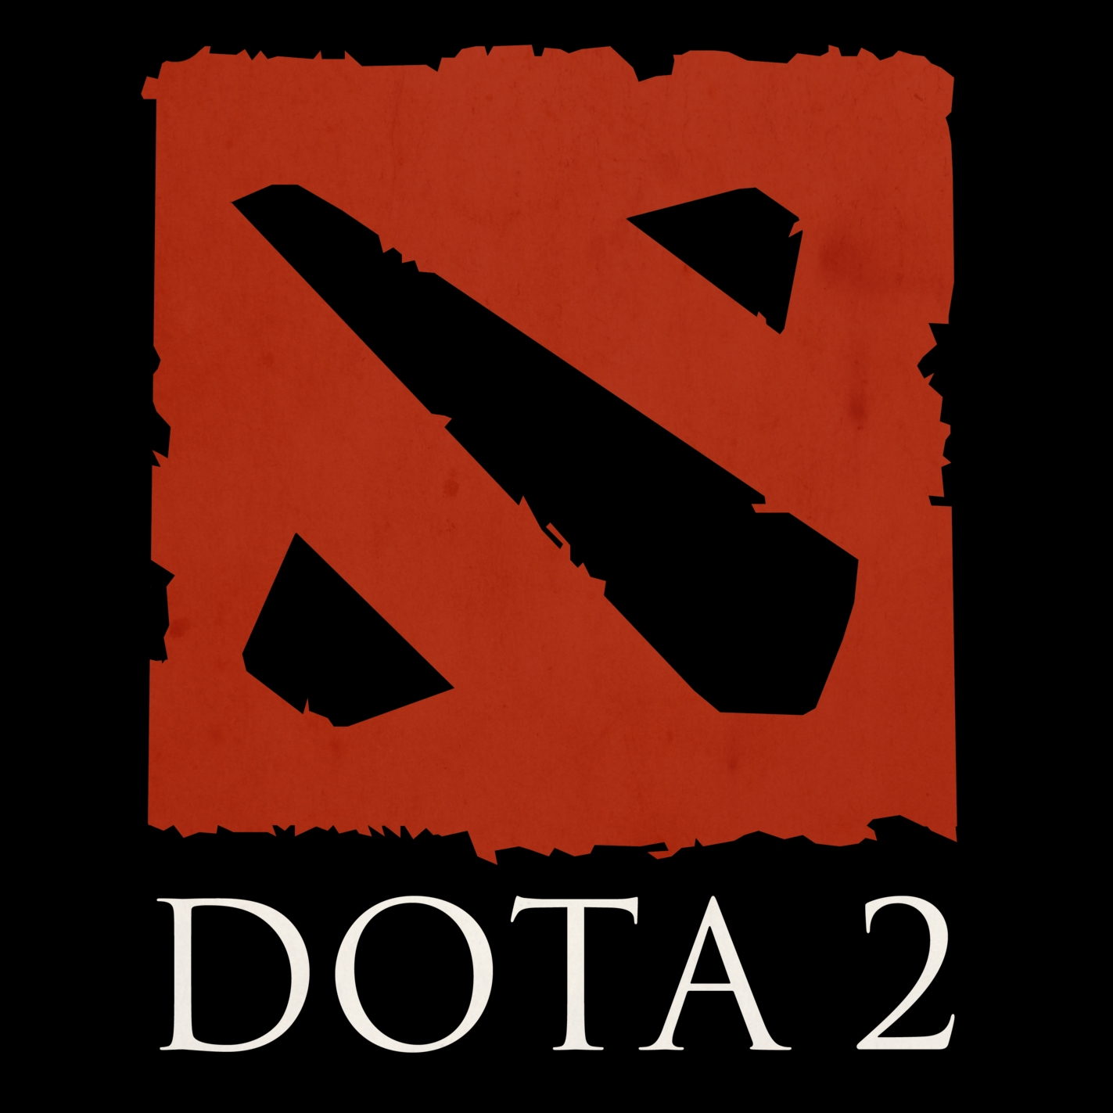
Background
Cooperative multiplayer game, MOBA
7.86 million people playing worldwide
Played by two team of 5 players
Requires teamwork, communication, and cooperation
Focus on strategy
Current matchmaking is done on a ranking system

Slide 4
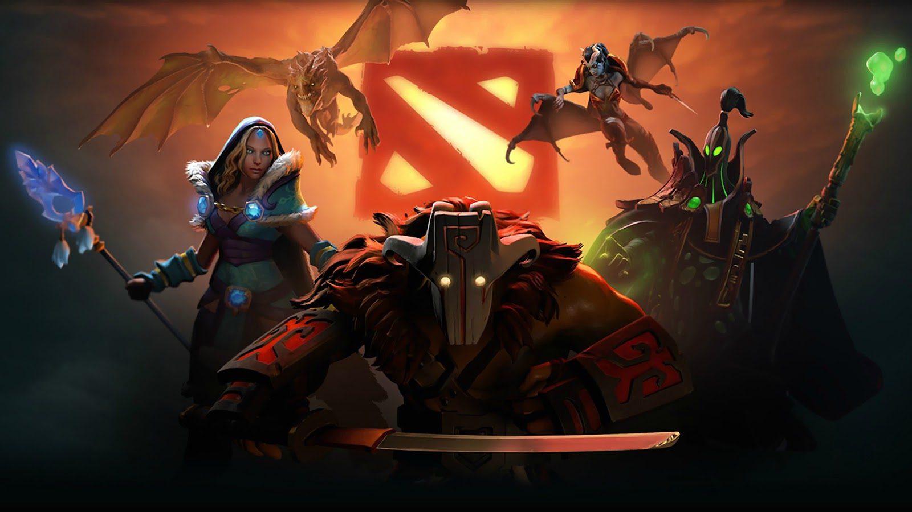
Issues
Games are filled with negative attitudes
Rank ≠ Skill
New player retention is low
Poor communication
One player can affect the outcome
Players don’t trust strangers

Slide 5
observations
Dota isn’t friendly to players who play alone
Teamwork is encouraged but hard to enforce
Players may speak different languages
Some players are hostile towards others
Enjoyment of the game is increased when playing with friends
One session is a significant time investment (~40 minutes)

Slide 6
Insight
Interacting with friends is more enjoyable
Gameplay quality is improved through coordination
People often dismiss social consequences on the Internet
Players hide behind anonymity
No repercussions for their actions
Optimal team play requires selflessness

Slide 7
Analysis
Focus can become less result oriented
Each game works toward building a long term relationship
Teammates rely on each other for self-improvement
Assessing weaknesses in a constructive manner
Current matchmaking system does not help users find long term teammates
Players learn more and perform better with positive reinforcement
The best way to encourage teamwork is to make players care about their teammates

Slide 8
Analogy
Dota is like trying to climb a mountain with a team full of strangers tied together.
Lots of shouting in different languages, including profanity.
People pull in different directions and some even try to go downhill.
The ones who are closer to the summit than you will throw rocks at you for no apparent reason.
Eventually you will feel like jumping off the mountain just to escape them

Slide 9
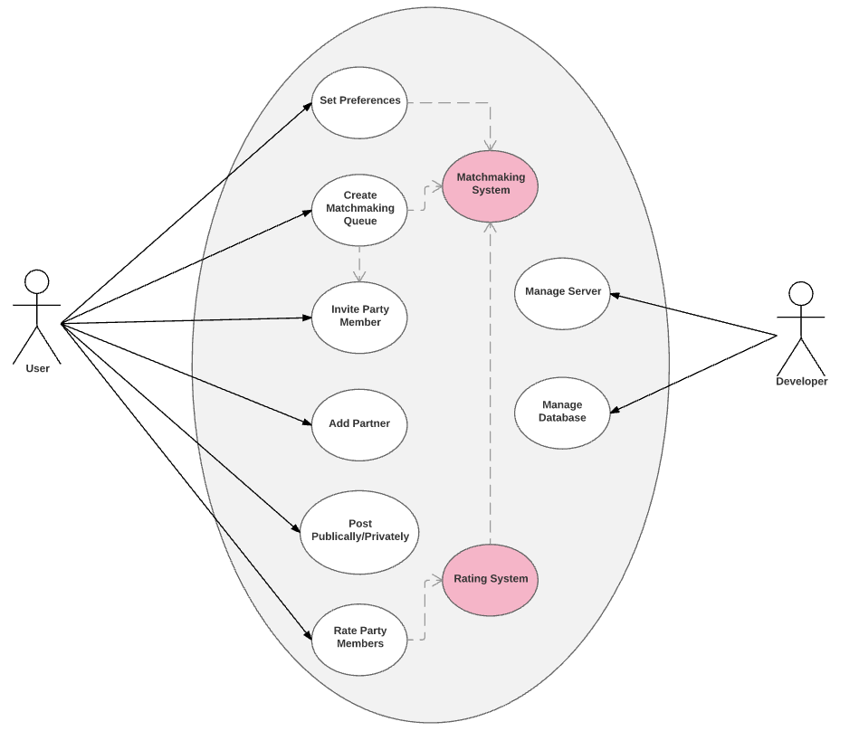
Use case diagram

Slide 10
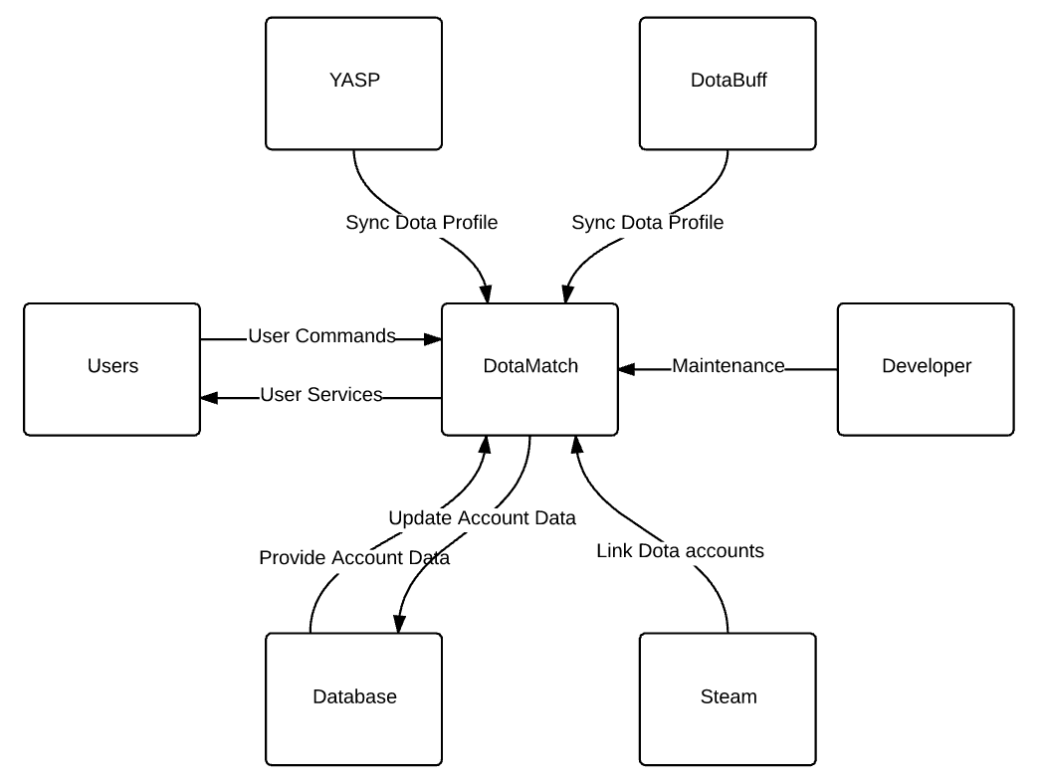
Context diagram

Slide 11
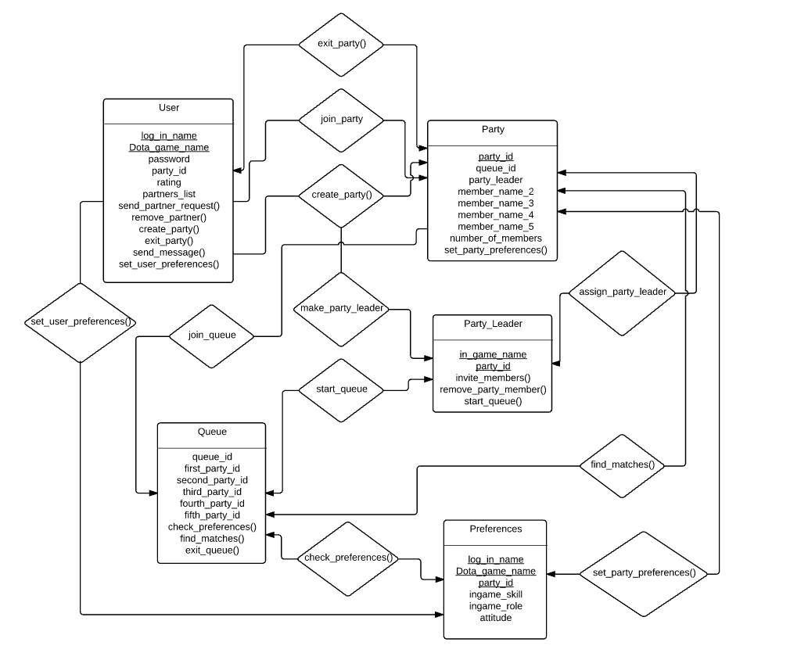
Class relationship/interaction diagram

Slide 12
Motivation
Customers
Stakeholders
Freedom of choice
Positive experience
Gain long lasting friends
Increase win-rate
Less complaints/reports
Increase Dota user-base
Increase revenue

Slide 13
Goal
Positive experience regardless of outcome
Players are more likely to keep playing if they find friends to play with
Create better games through teamwork and coordination
Make match statistics more accessible
Extend our matchmaking services to other games and platforms

Slide 14
Post implementation review
What we did right:
What we did wrong:
Deliverables were completed & submitted on time
Well though-out requirements
Worked as a team
Time management
Schedule more in-person meetings
Not enough self-checks & reviews

Slide 15
Questions/answers
Thank You!

